Slide 1
IoT프로그래밍 7주차 과제
YA반 학번: 20202296 이름: 전채린

Slide 2
과제1 다음에 대한 해결 방법을 적으세요
ABOT이 더 민감하게 하려면?
speedLeft = int(200.0 - (ndShade * 1500.0));
2) ABOT이 덜 민감하게 하려면?
speedLeft = int(200.0 - (ndShade * 500.0));
3) ABOT이 어둠을 쫓아가도록 하려면?
if(ndShade > 0.0) // Shade on right?
{ // Slow down right wheel
speedRight = int(200.0 - (ndShade * 10000.0));
speedRight = constrain(speedRight, -200, 200);
speedLeft = 200; // Full speed left wheel
}
else // Shade on left?
{ // Slow down left wheel
speedLeft = int(200.0 + (ndShade * 1000.0));
speedLeft = constrain(speedLeft, -200, 200);
speedRight = 200; // Full speed right wheel
}

Slide 3
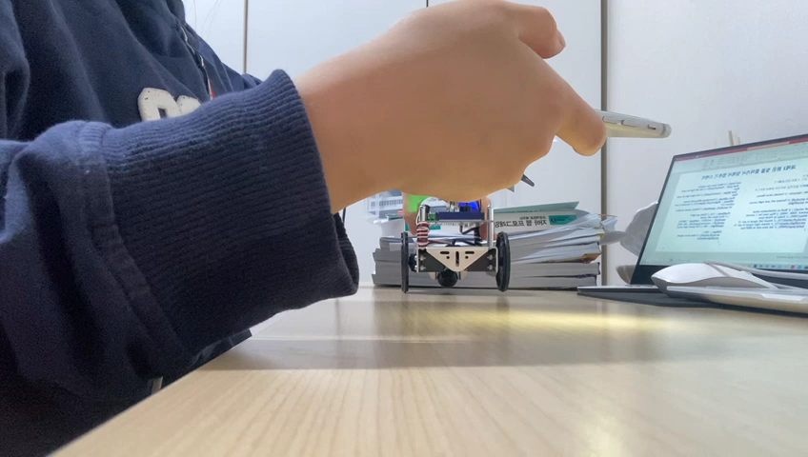
과제2 밝은 빛을 쫓아가서 빛에서 멈추기 동작 영상

Slide 4
과제2 밝은 빛을 쫓아가서 빛에서 멈추기 스케치
/* Volts10 */
/* ABOT 유도 스케치 실습과제3 */
/*
* 1) ABOT이 밝은쪽을 쫓아가서 빛에서 멈추도록
*/
#include <Servo.h> // Include servo library
Servo servoLeft; // Declare left and right servos
Servo servoRight;
void setup() { // Built-in initialization block
tone(4, 3000, 1000); // Play tone for 1 second
delay(1000); // Delay to finish tone
servoLeft.attach(13); // Attach left signal to pin 13
servoRight.attach(12); // Attach right signal to pin 12
Serial.begin(9600); // Set data rate to 9600 bps
}
void loop() { // Main loop auto-repeats
float tLeft = float(rcTime(8)); // Get left light & make float
float tRight = float(rcTime(6)); // Get right light & make float
float ndShade; // Normalized differential shade
ndShade = tRight/(tLeft+tRight)-0.5; // Calculate it and subtract 0.5
int speedLeft, speedRight; // Declare speed variables
if(ndShade > 0.0) // Shade on right?
{ // Slow down left wheel
speedLeft = int(200.0 - (ndShade * 1000.0));
speedLeft = constrain(speedLeft, -200, 200);
speedRight = 200; // Full speed right wheel
if(tLeft < 100) {
servoLeft.detach(); // Stop servo signals
servoRight.detach();
}
}

Slide 5
과제2 밝은 빛을 쫓아가서 빛에서 멈추기 스케치
long rcTime(int pin) // returns decay time
{
pinMode(pin, OUTPUT); // Charge capacitor
digitalWrite(pin, HIGH); // by setting pin output-high
delay(5); // for 5 ms
pinMode(pin, INPUT); // Set pin to input
digitalWrite(pin, LOW); // with no pullup
long time = micros(); // Mark the time
while(digitalRead(pin)); // Wait for voltage < threshold
time = micros() - time; // Calculate decay time
return time; // Return decay time
}
// maneuver function
void maneuver(int speedLeft, int speedRight, int msTime)
{
servoLeft.writeMicroseconds(1500 + speedLeft); // Set left servo speed
servoRight.writeMicroseconds(1500 - speedRight); // Set right servo speed
if(msTime == -1) // if msTime = -1
{
servoLeft.detach(); // Stop servo signals
servoRight.detach();
}
delay(msTime); // Delay for msTime
}
else // Shade on left?
{ // Slow down right wheel
speedRight = int(200.0 + (ndShade * 10000.0));
speedRight = constrain(speedRight, -200, 200);
speedLeft = 200; // Full speed left wheel
if(tRight < 100) {
servoLeft.detach(); // Stop servo signals
servoRight.detach();
}
}
maneuver(speedLeft, speedRight, 20); // Set wheel speeds
// Display heading
Serial.println("tLeft ndShade tRight");
Serial.print(tLeft); // Display tLeft value
Serial.print(" "); // Display spaces
Serial.print(ndShade); // Display ndShade value
Serial.print(" "); // Display more spaces
Serial.print(tRight); // Display tRight value
Serial.println(" "); // Add an extra newline
delay(1000); // 1 second delay
}

